Slide 1
Stage 10: Calculating with money

Slide 2
Learning Objective:
To calculate with money and give change
Today, we will be setting up farm shops so we can practise selling our products but first we need to decide on selling prices for the products we have made.
What information with help us do this?

Slide 3
Deciding on a selling price
When we are deciding on a price for our product we need to ensure we charge enough to cover the cost of making each product but not so much that your customers will take their business elsewhere!
For example: if it cost £1 to make each bread product then your selling price needs to be more than £1.

Slide 4
Deciding on a selling price
Decide on selling prices for both of your products and add them to your advertisements.

Slide 5
Calculating with money
You sell three flower products for 30p each. What is the total order cost?
You sell two bread products for £1 and 40p each. What is the total order cost?
You sell one bread product for £1 and 20p and two flower products for 32p each. What is the total order cost?
A customer spends 75p in your shop. They pay with a £1 coin. How much change should you give them?
A customer spends 48p in your shop. They pay with three 20p coins. How much change should you give them?
A customer buys four flower products for 15p each. They pay with a 50p and a 20p. How much change should you give them?

Slide 6
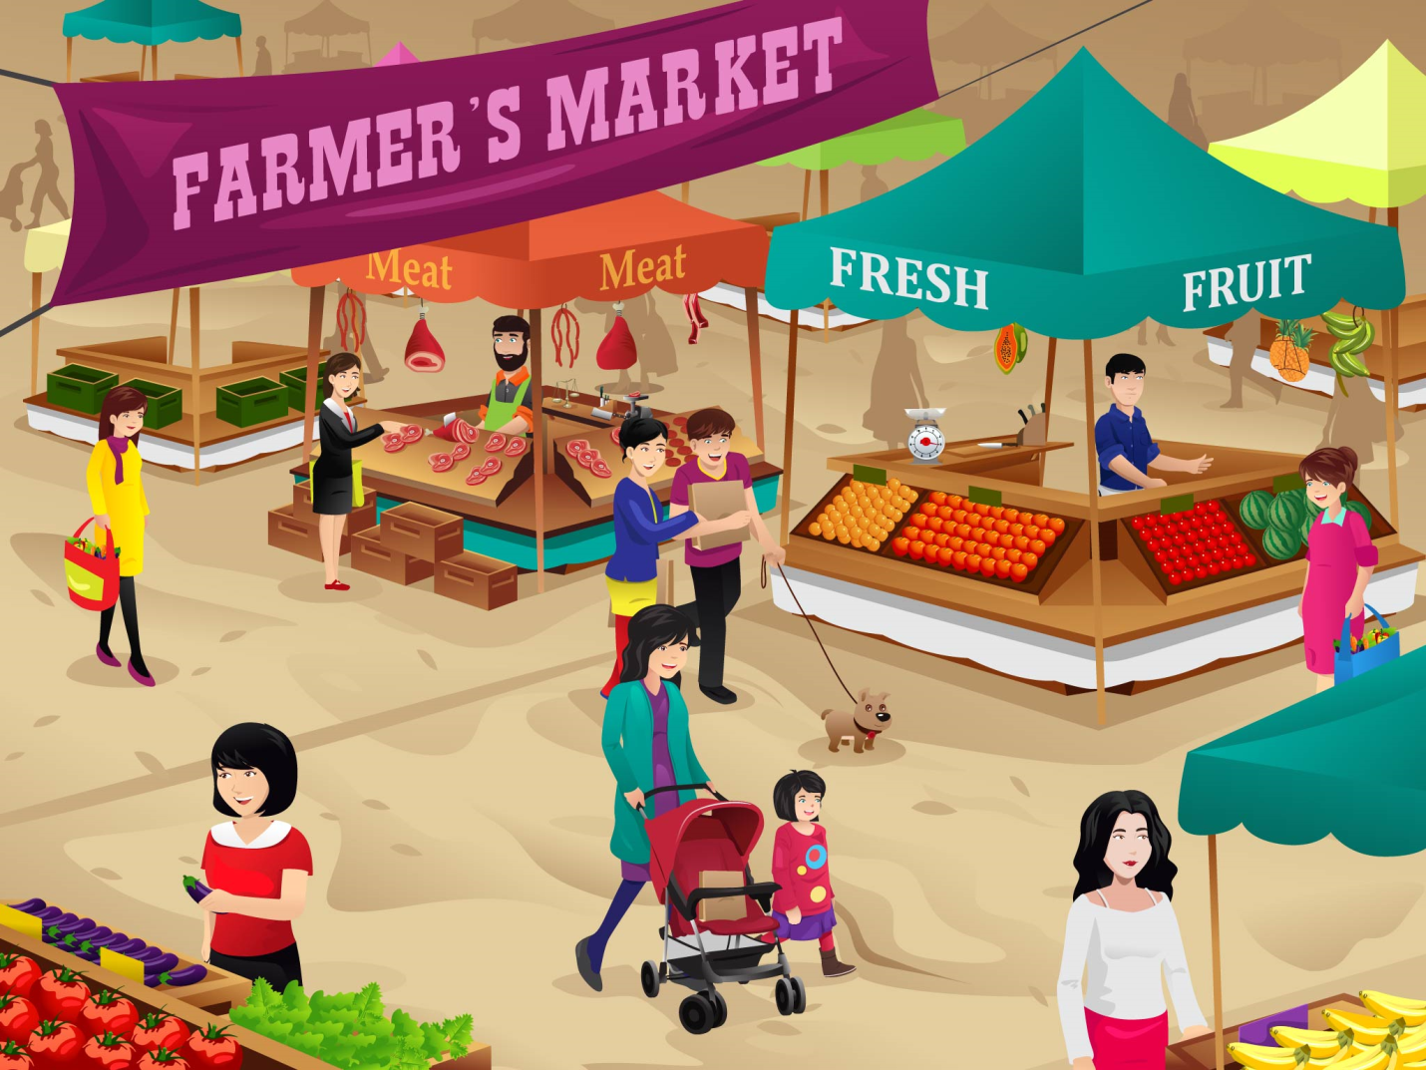
Let’s play farm shops!

